Slide 1
Codefreaks
Hello World :)
By : Nikhil, Satin, Varun, Aayush, Muskan

Slide 2
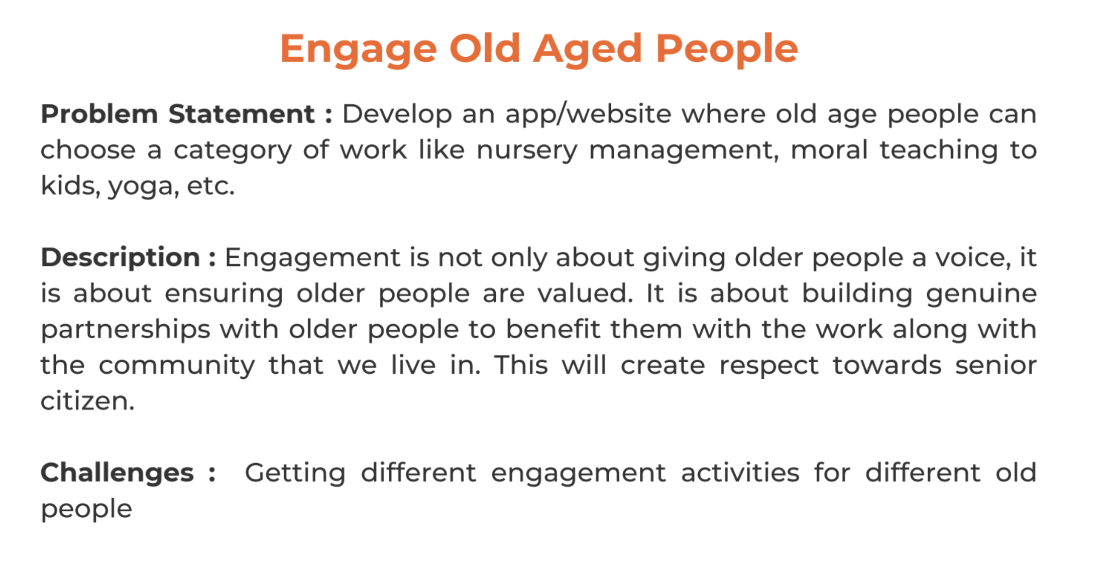
Problem statement

Slide 3
APPROACH
We are aware that how people suffer from loneliness when they get older. So in order to eradicate their loneliness, we have come up with an idea which will help them communicate and socialise among themselves. So, here we are designing an android app as well as a website which will help the old people to interact with each other, initially one-to-one then in future since the interaction would have increased it will allow them to form communities which later our app would approve of.

Slide 4
PROPOSED SOLUTION
We would be assuming that we have access to the Aadhar Card details, we will use Aadhar details to authenticate the user details.
User can propose the meeting time and place.
We will suggest similar users who are having some meet up plans in and around with similar interest.
We would also be informing respective guardians about their meet up in order to make the whole process more secure.
Leading them to a perfect bum around and an amazing meet up. Finally leading to Community Development.

Slide 5
Tech stack to be used
Website
HTML, CSS, JS, Jquery, Bootstrap, Google Places APIs in Frontend
Node JS and MongoDB in the Backend
To be deployed on Heroku

Slide 6
Tech Stack to be USED
Android App
Java, XML, Google Places API

Slide 7
Thank you :)

